Slide 1
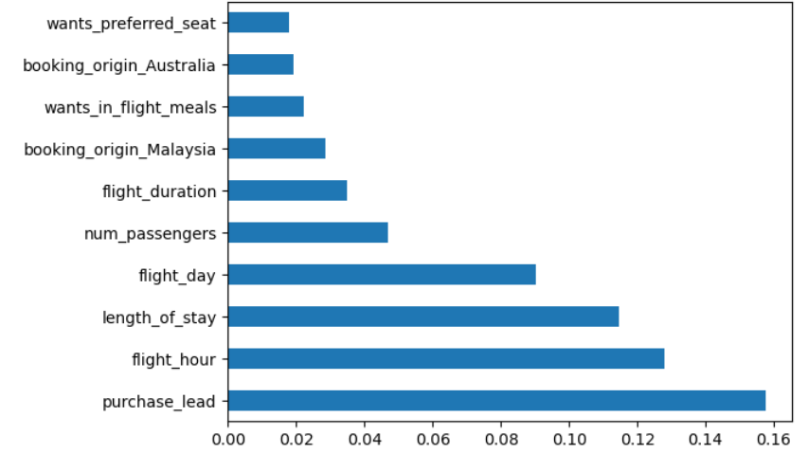
Customer Booking Prediction – Model Summary
Model Used
Random Forest Classifier
Chosen for strong performance and interpretability
Model Performance
Accuracy: 85.5%
Model shows good ability to distinguish between booking and non-booking customers
Business Insight
Customers with prior engagement and travel history are significantly more likely to book
Model can support targeted marketing and early intervention strategies
Notes:
The PowerPoint template was not available in the resources provided, so this slide was created independently following the task guidelines.

